Slide 1
Source Routing with Protocol-oblivious Forwarding to Enable Efficient e-Health Data Transfer
Author: Shengru Li, Daoyun Hu, Wenjian Fang and Zuqing Zhu
Publisher: 2016 IEEE International Conference on Communications Presenter: Yi-Tsung Huang
Date: 2017/02/22
Department of Computer Science and Information Engineering
National Cheng Kung University, Taiwan R.O.C.
Notes:
1

Slide 2
Introduction
In order to support Big Data applications more efficiently, WANs also need a more programmable and adaptive architecture with effective network control and management (NC&M), which is similar to the innovation trends in other types of networks.
Thanks to the advances on SDN, the Big Data related traffic can be managed more efficiently in WANs.

Slide 3
Introduction
However, due to the large-scale and geographically-distributed nature of WANs, the scalability could become a critical issue when incorporating SDN for WANs.
Specifically, when the traffic volume increases, more and more flow-tables will be installed in the switches, which can use up their memory, make the table look-up and traffic scheduling increasingly complex, and increase the communication overhead significantly.
Notes:
This is because OpenFlow defines protocol-dependent flow-matching rules, which can lead to repeated flow-table installations and look-ups in the forwarding plane.

Slide 4
Introduction
In this paper, we design and implement a novel network system that can leverage source routing with POF to facilitate efficient e-Health data transfers with low setup latency.
We develop the POF-based source routing protocol, and experimentally demonstrate that with the proposed scheme, the flow-tables installed in each core switches in a POF-controlled SD-WAN can be minimized.

Slide 5
POF Primer
Basically, POF inherits the network architecture of OpenFlow.
However, the innovations provided by POF are the protocol-oblivious description for 􀃀flow-matching fields and a set of generic flow instructions, with which protocol-independent packet forwarding can be realized easily in the switches.

Slide 6
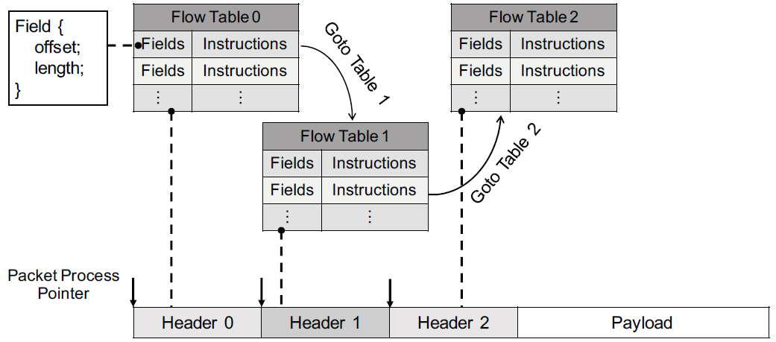
POF Primer

Slide 7
POF Primer
Matching Fields: POF simply defines the search key of a matching field as a tuple <offset, length>.
POF-FIS: All the instructions in POF-FIS utilize the tuple <offset, length> to locate the data that they need to operate on.

Slide 8
POF Primer
Flow Tables: The flow tables stored in a POF-enabled switch can be classified into four types, i.e., the masked-match(MM), the longest-prefix-match(LPM), the exact-match(EM) and the direct table(DT).
Metadata Memory: When a switch needs to handle multiple tables in packet forwarding, it uses metadata memory to store the flow information that the current table processing generated for the next.

Slide 9
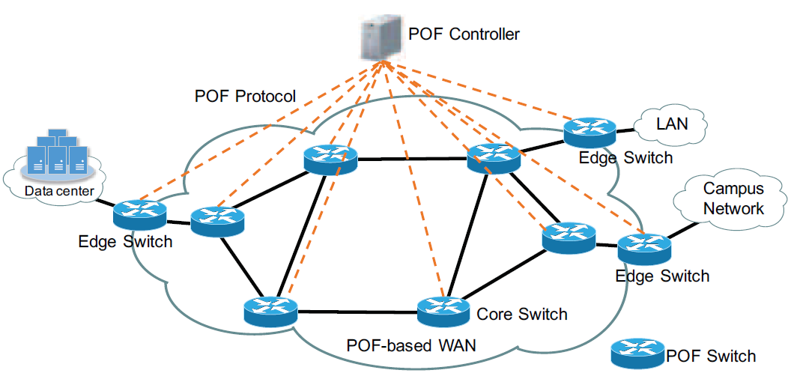
POF-based Source Routing in SD-WAN

Slide 10
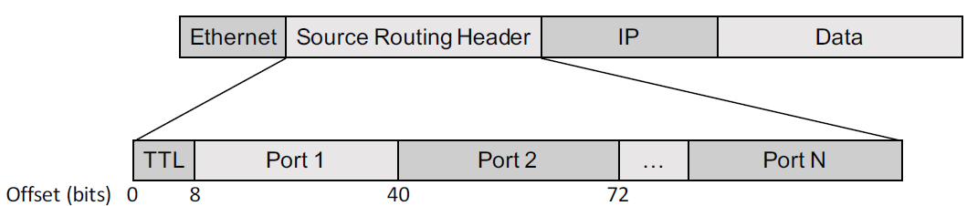
POF-based Source Routing in SD-WAN
- Packet Design for Source Routing
The packet fields can be tailored specially to enable efficient source routing.

Slide 11
POF-based Source Routing in SD-WAN
The ingress edge switch stores the output ports in its metadata memory, and will insert them into every packet of the flow by using POF-FIS.
The subsequent core switches use a pre-installed pipeline-like matching rule that consists of multiple flow tables to process the packets.

Slide 12
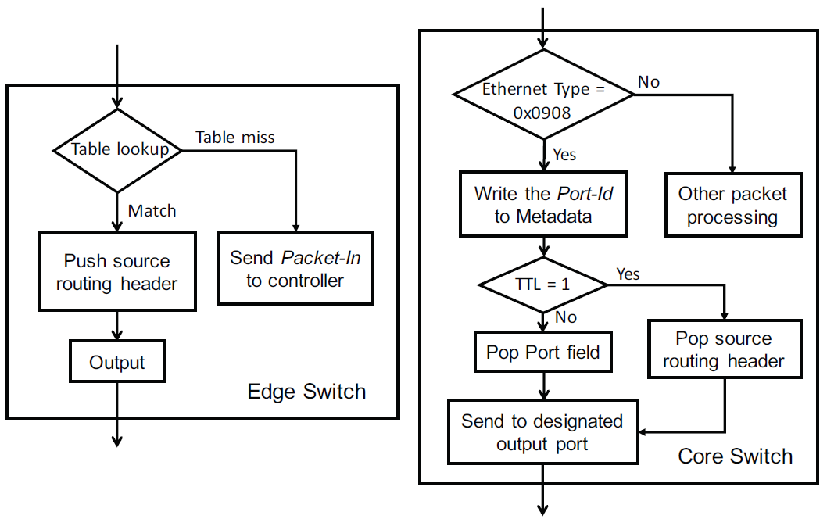
POF-based Source Routing in SD-WAN

Slide 13
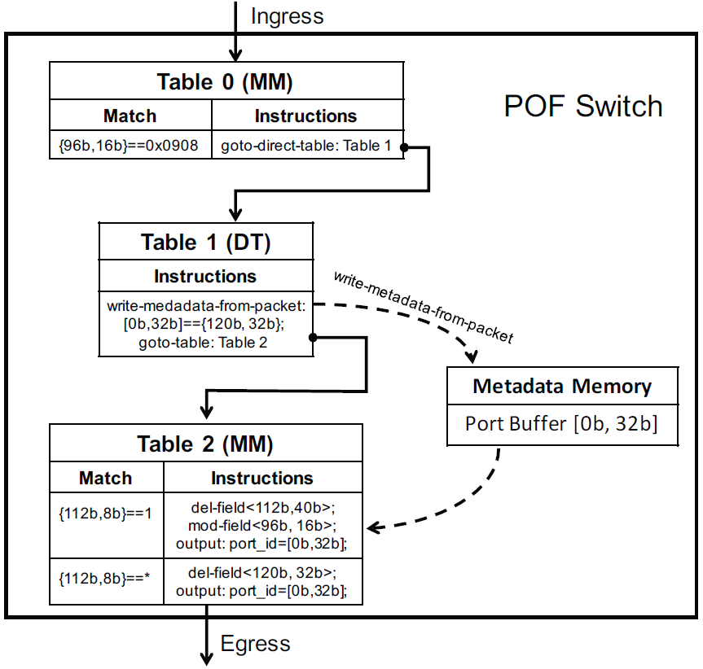
POF-based Source Routing in SD-WAN

Slide 14
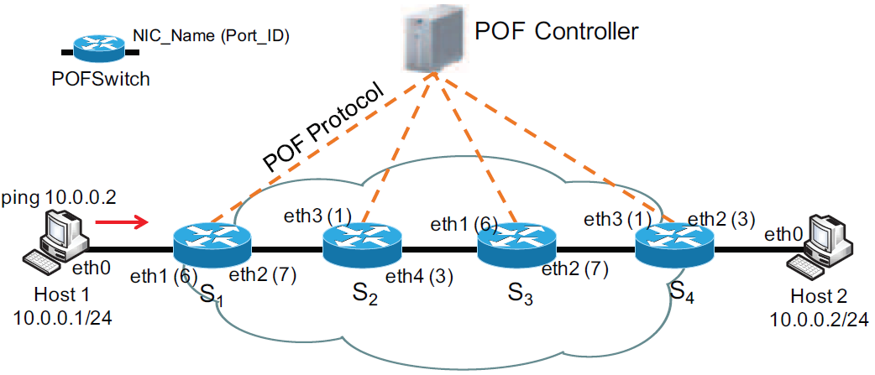
Experimental Demonstration

Slide 15
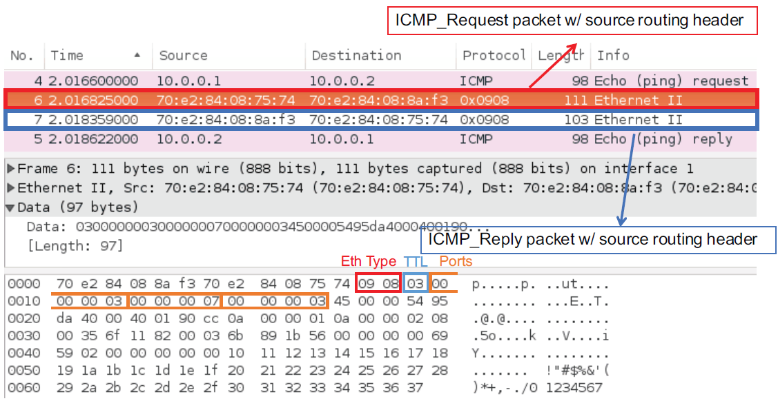
Experimental Demonstration

Slide 16
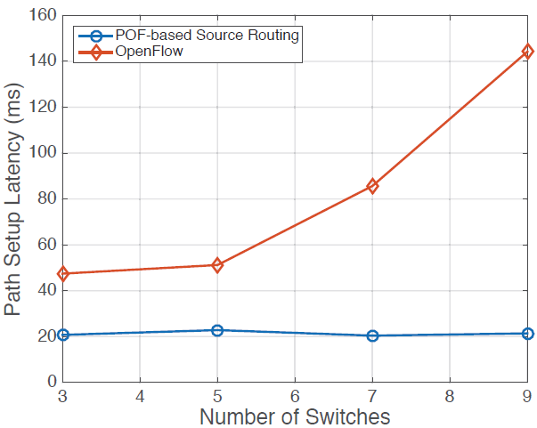
Experimental Demonstration
Notes:
用mininet模擬，一直增加core switch

